Slide 1
Lectuer-2 Database Design and Applications
Ashish Narang

Slide 2
First Semester
2020-21

Slide 3
Contents
Steps in Database Design Process
ER Concepts (Entities, Attributes, Associations etc.)
ER Notations
Class Hierarchies

Slide 4
Major Steps in Database
Design Process
Requirement Analysis
Understanding the domain
Identifying the data to be stored
Identifying the constraints
Conceptual Database design
E-R modeling
Logical Database Design
Designing tables and relationships
Refinement of schema
Physical database design
Indexing
Storage formats

Slide 5
ER Model
An E-R model is a detailed logical representation of the data for an organization or for a business area. An ER model normally is expressed as an Entity-Relationship diagram (ER diagram), which is a graphical representation of an ER model.
The basic components of an ER model are
Entities
Relationships
Attributes

Slide 6
Entity
Entity is an object in the real world that is distinguishable from all other objects.
Entity has independent existence.
For Example, a particular person, car, house or employee.

Slide 7
Attributes
Attributes are properties or characteristics possessed by an entity.
For example, Employee entity may be described by the attributes Employee name, Age, Address, Salary and Job etc.
A Particular entity will have value for each of its attributes.

Slide 8
Attributes Types
Several types of attributes occur in E-R Model
Simple
Composite
Single valued
Multi-valued
Derived

Slide 9
Simple and Composite Attributes
A simple attribute can not be divided into subparts.
Simple attribute are also called atomic.
A composite attribute can be subdivided into subparts which represents more basic attributes with independent meaning.
For Example, Address attribute of Employee Entity can be divided into street_address, city, state and zip.

Slide 10
Single valued and Multi-valued Attributes
A single-valued attribute is the one will have only one value for a given entity instance.
For Example, Age is a single valued attribute
A multi-valued attribute is the one which will have more than one value for a given entity instance.
For Example, Color attribute of a car

Slide 11
Derived Attributes
A derived attribute is the one which is derived or calculated from other related attributes.
In Some cases, two attribute values are related.
For Example, Age and Birth_date attributes of a person.
For a particular person entity, the value of age can be determined from the current date and the value of that persons birth date.
Birth date is called as stored attribute.

Slide 12
Entity Types and Entity Sets
An Entity type defines a collection of entities that have same attributes. Each entity type in the database is described by its name and attributes.
The Collection of all the entities of a particular entity type in the database at any point in time is called an entity set.

Slide 13
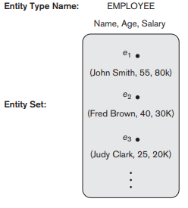
Contd..

Slide 14
Value Sets of Attributes
Each simple attribute of an entity type is associated with a value set, which specifies the set of values that may be assigned to that attribute for each individual entity.
For example, if the range of ages allowed for employees is between 16 and 70, we can specify the value set of Age attribute of Employee to be set of integer numbers between 16 and 70.

Slide 15
Weak Entity
An entity whose existence depends on some other entity.
The entity on which the weak entity depends is called the identifying owner (or simply owner).
A weak entity does not have its own identifier.
Generally in an ER diagram a weak entity has an attribute that serves as a partial identifier.
The relationship between a weak entity and its owner is called an identifying relationship.

Slide 16
Relationships
A relationship represents an association between two or more entities. An example of a relationship would be
Employees are assigned to projects
Department manage one or more projects

Slide 17
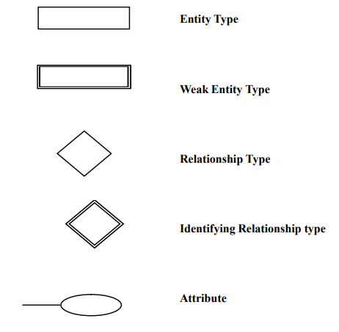
Notations Used in ER diagrams

Slide 18
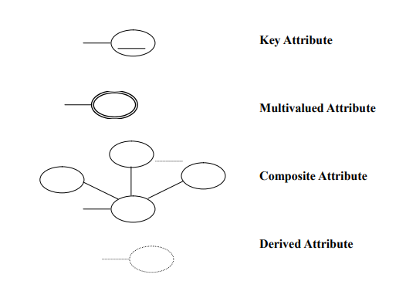
Contd..

Slide 19
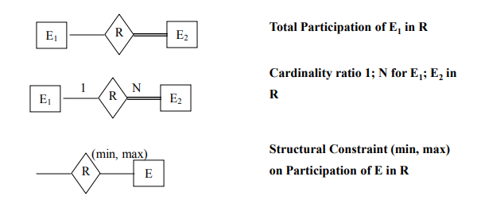
Contd..

Slide 20
Degree of a Relationship
The degree of a relationship is the number of entities associated with the relationship.
Unary Relationship
Binary Relationship
Ternary Relationship

Slide 21
Cardinality of Relationship
The cardinality ratio for a binary relationship specifies the maximum number of relationship instances that an entity can participate in.
One to One
One to Many
Many to Many

Slide 22
Participation Constraint
The participation constraint specifies whether the existence of one entity depends on its being related to another entity via relationship type.
There are two types of participants constraints
Total
Partial

Slide 23
A Sample Database
The COMPANY database keeps track of a company’s employees, departments, and projects. Suppose that after the requirements collection and analysis phase, the database designers provide the following description of the miniworld—the part of the company that will be represented in the database.
The company is organized into departments. Each department has a unique name, a unique number, and a particular employee who manages the department. We keep track of the start date when that employee began managing the department. A department may have several locations.

Slide 24
Contd..
A department controls a number of projects, each of which has a unique name, a unique number, and a single location.
We store each employee’s name, Social Security number, address, salary, gender, and birth date. An employee is assigned to one department, but may work on several projects, which are not necessarily controlled by the same department. We keep track of the number of hours per week that an employee works on each project. We also keep track of the direct supervisor of each employee (who is another employee).

Slide 25
Contd..
We want to keep track of the dependents of each employee for insurance purposes. We keep each dependent’s first name, gender, birth date, and relationship to the employee.

Slide 26
Identify the Entities
Employee
Department
Project
Dependent

Slide 27
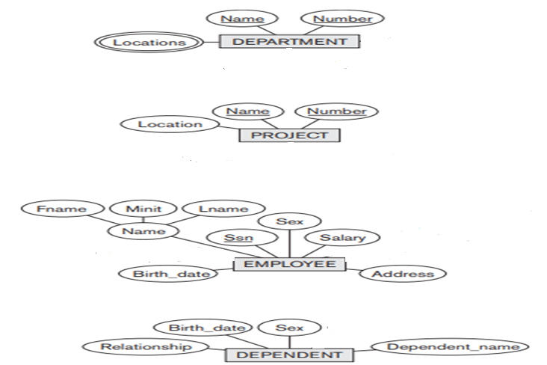
Contd..

Slide 28
Relationships
Employee manages Department
Employee works for Department
Department controls project
Employee supervises Employee
Employee works on projects
Employee has Dependents

Slide 29
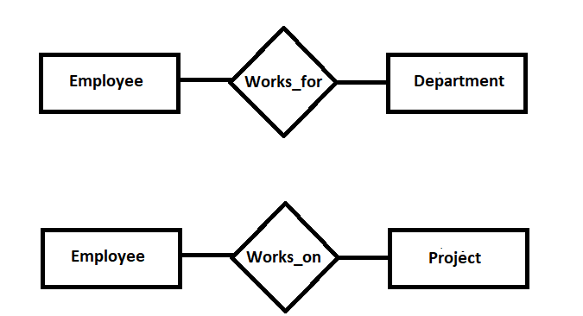
Contd..
N
1
M
N

Slide 30
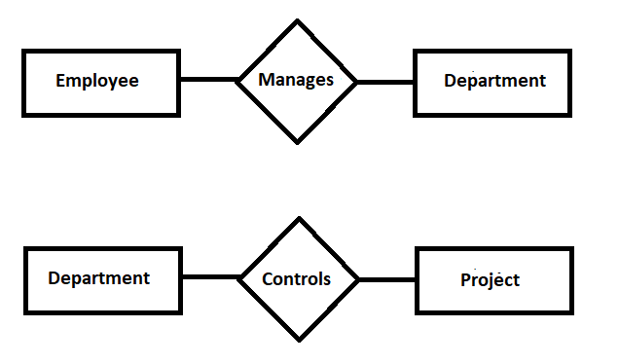
Contd..
1
1
1
N

Slide 31
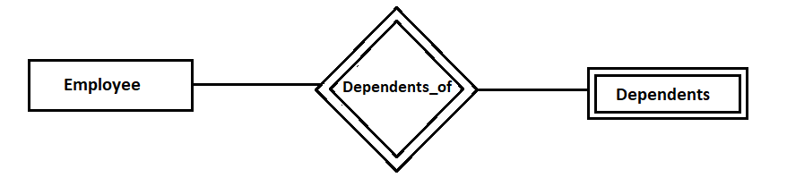
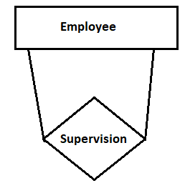
Contd..
1
N
Supervisee
Supervisor

Slide 32
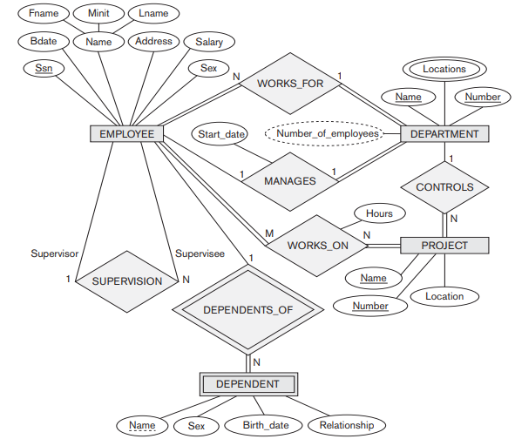
ER Diagram of Company Database

Slide 33
University Management System
Consider a university with many departments. Each department has unique D.no, D_name and location. A department can offer any number of courses. Several professors work for a department. Each Professor is given a unique code, name and contact number. Each professor works for one department. Each department has one professor as head. A Professor can head only one department and can teach 2 to 4 courses. A student can enroll for any number of courses. A course can be taught by multiple professors. Each course has some credits associated with it and can have any number of students. Each student has unique Rollno, Name and Address.

Slide 34
Identify the Entities
The different entities are
Department
Course
Professor
Student

Slide 35
Identify key Attributes
Following are the primary key attributes for each entity
Dno(Department number) key attribute of Department
C_code(Course Code) key attribute of Course
Roll_no(Roll number) key attribute of Student
P_code(Professor code) key attribute of Teacher

Slide 36
Identify other Relevant Attributes
Department entity will have
dname
loc
Course entity will have
c_name
credits
Professor will have
Name
mob_no
Student entity will have
Name
address

Slide 37
Identify Relationships
Department Offers Courses
Department has Professors
Student Enroll for Courses
Professors teach Courses
Professor heads Department

Slide 38
Draw E-R Diagram
Dno
Dname
loc
C_code
C_name
credits
1
Offers
N
Department
Course
1
N
1
N
Teaches
Enroll
has
heads
1
M
N
M
Professor
Student
P_code
name
mob_no
Roll_no
Name
Address

Slide 39
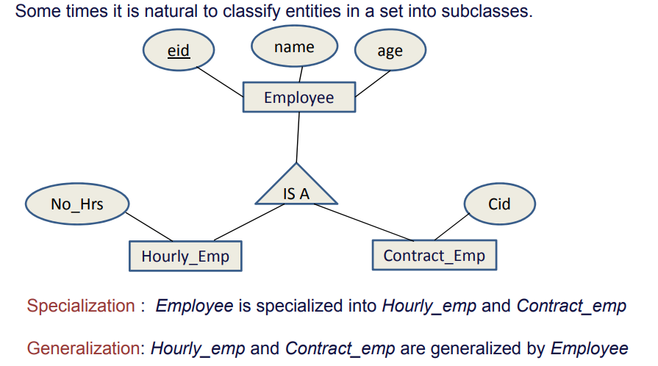
Class Hierarchies

Slide 40
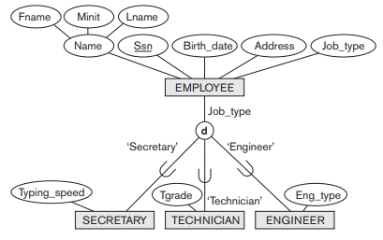
Disjointness

Slide 41
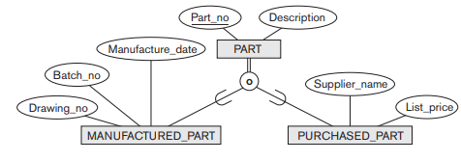
Overlapping

